Slide 1

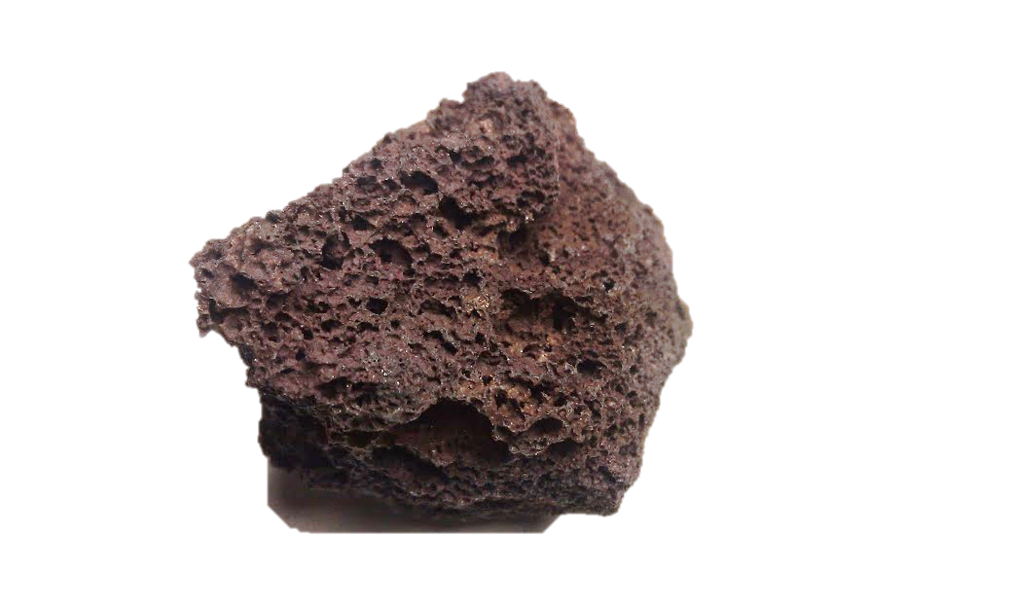
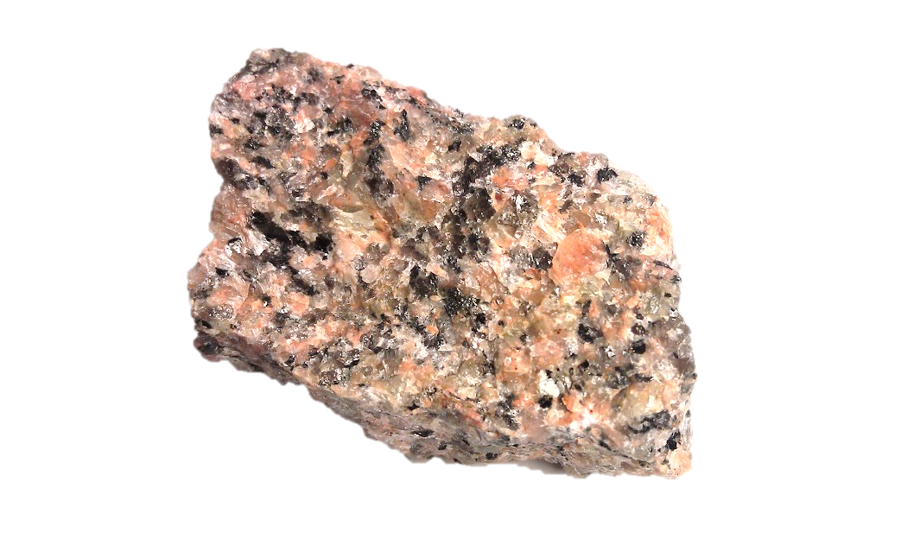
All About the Rock Cycle

Slide 2
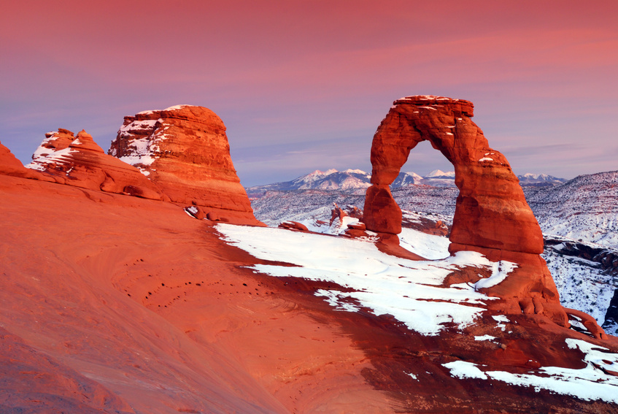
Many events in nature happen in cycles.
Rocks go through a series of changes called the rock cycle.

Slide 3


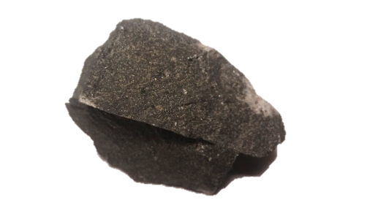
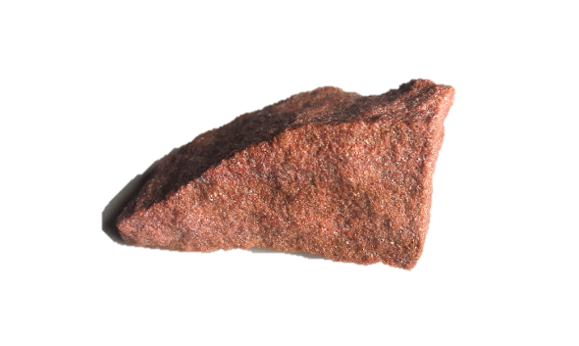
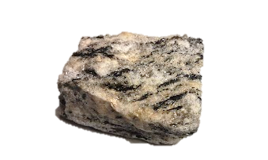
Igneous Rock
Magma
Sedimentary Rock
Metamorphic Rock

Slide 4

It looks complicated but you can handle it! The rock cycle can happen a few different ways. Let’s trace the lives of these characters to see how it works!

Slide 5
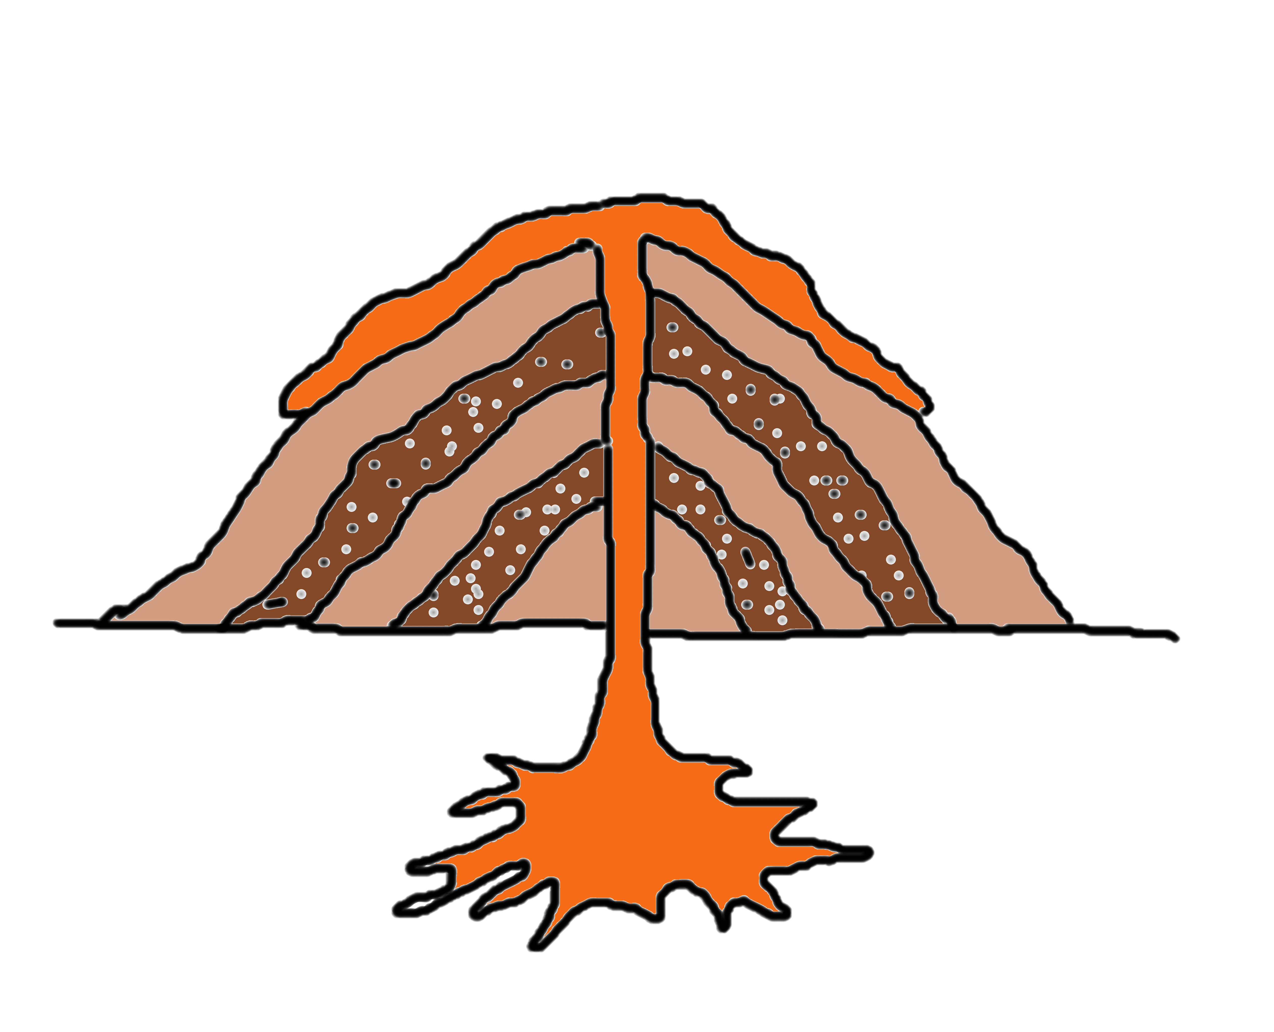


Geo lived underground as a blob of magma.
On your diagram, put a star on MAGMA, this is where we’ll start.

Slide 6
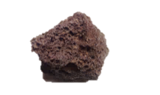
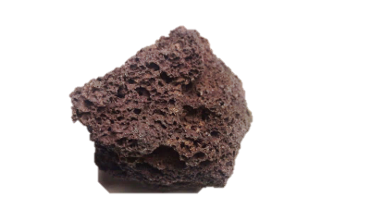


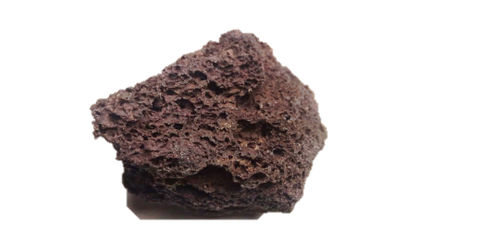
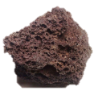
One explosive day, Geo was forcefully thrown from her home.
When she cooled off, she found that she was now a scoria rock.
Trace the line from MAGMA to IGNEOUS ROCK.

Slide 7
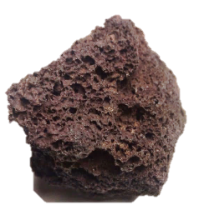
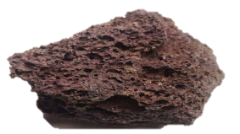
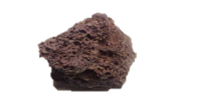
Life on the surface of the Earth was harsh. Many years of rain and ice caused Geo to crack apart.

Slide 8



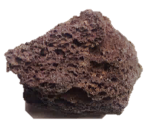
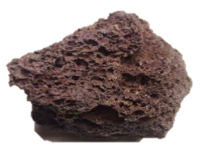



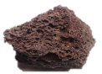
Her many pieces traveled down a river all the way to an ocean.

Slide 9
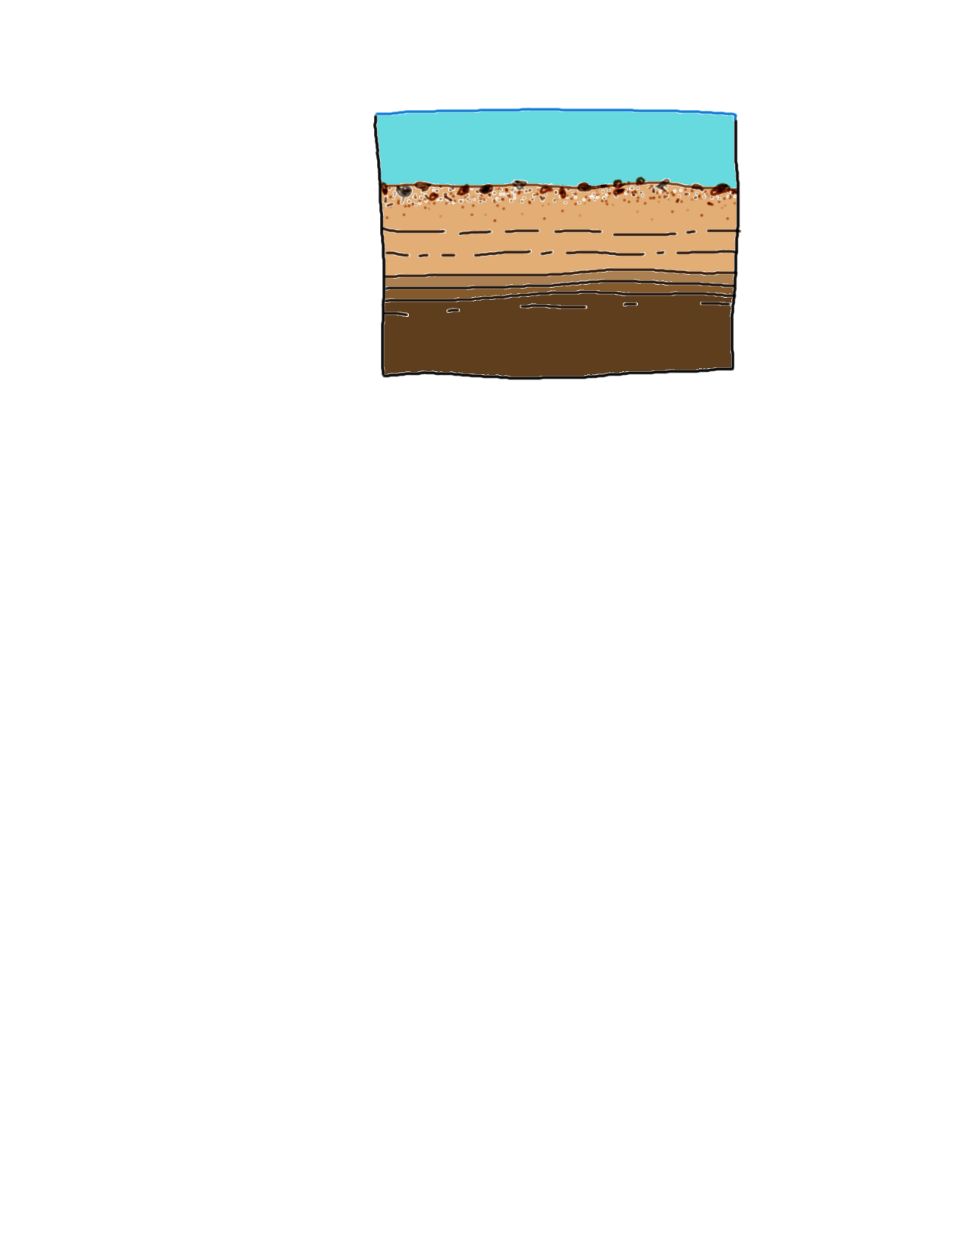
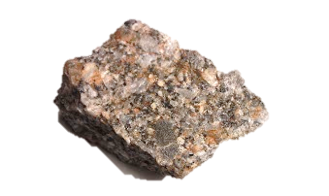
After many years of being buried and pressed together with other sediment, Geo’s pieces became a breccia rock.
Trace the line from IGNEOUS ROCK to SEDIMENTARY ROCK.

Slide 10
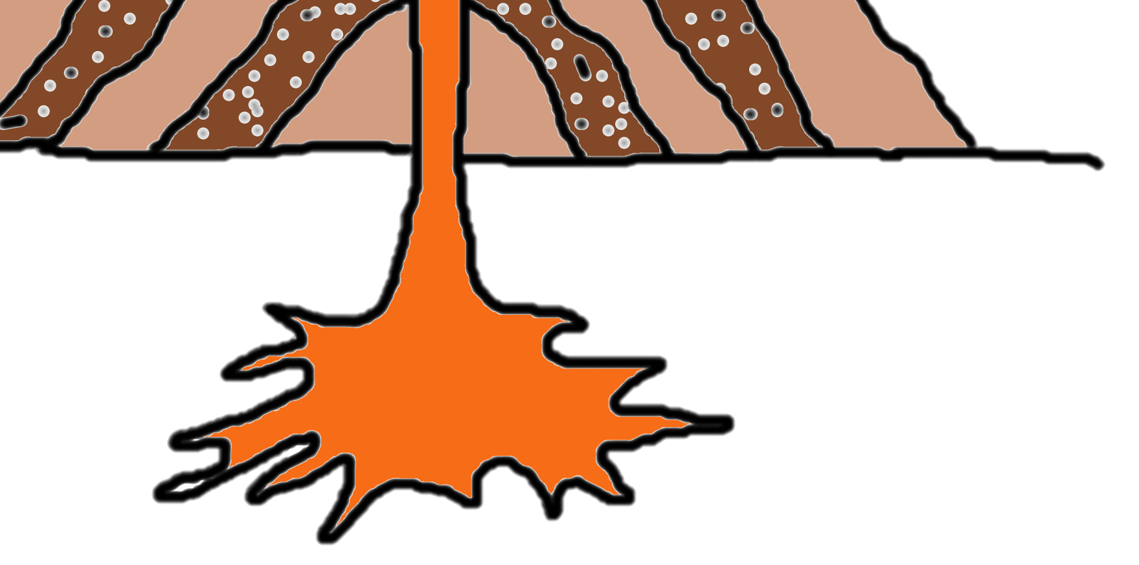
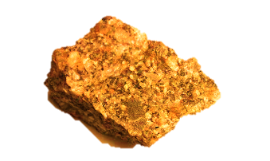
Geo was pushed deeper underground where it was very hot. She began to melt again… back into a blob of magma.
Trace the line from SEDIMENTARY ROCK back to MAGMA.

Slide 11
On your paper, figure out what will happen to Geo next.

Slide 12


Rocky was a hunky chunk of granite living a quiet life underground.
On your diagram, put a star on IGNEOUS ROCK. This is where we’ll start.

Slide 13
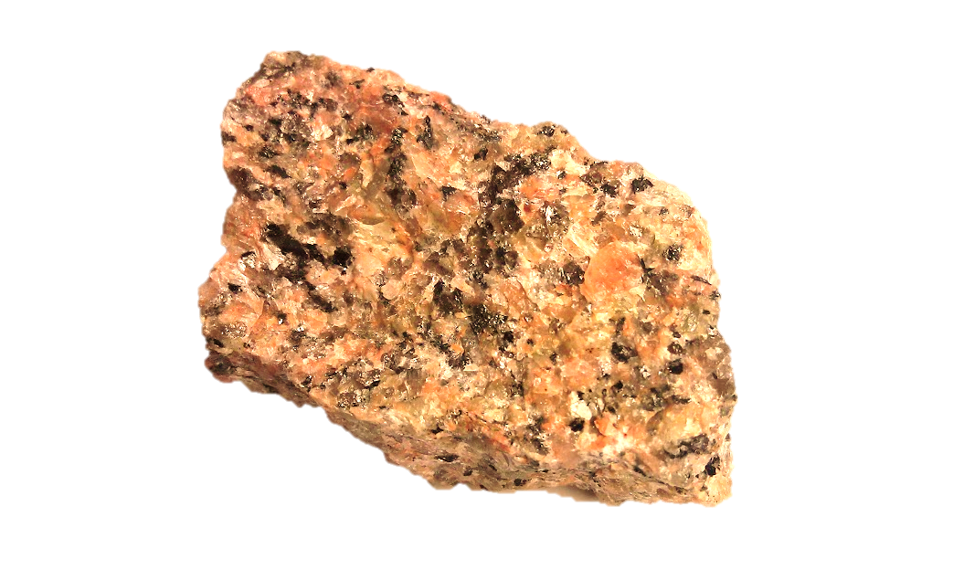
He got pushed further underground where it was hot and there was a lot of pressure from above.

Slide 14
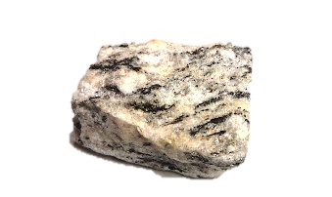
Eventually the heat and pressure got to him and Rocky changed into a gneiss (pronounced “nice”) rock. He enjoyed his snazzy new stripes.
Draw a line from IGNEOUS ROCK to METAMORPHIC ROCK.

Slide 15
One day a earthquake shook Rocky’s world and brought him up to the surface.

Slide 16



Rain water caused a river to run over Rocky. It washed little pieces of him down-stream.

Slide 17





The river dropped pieces of Rocky off at a beach where he soaked up the sun.

Slide 18


The ocean waves pulled Rocky’s pieces down to the sea floor.

Slide 19

And you guessed it…he was buried by layers of sand, dirt and rocks. Eventually he turned into sandstone.
Trace the line from METAMORPHIC ROCK to SEDIMENTARY ROCK.

Slide 20
On your own paper, figure out what will happen to Rocky next. There is more than one possible answer.

